Slide 1
Be A Prudent Investor
Basics of Stock Selection

Slide 2
Indian Capital Market - Overview
Market Regulator SEBI
Stocks and Commodities Derivative Exchanges
Depositories
Other Intermediaries
NSE, BSE, MSE, MCX etc.
NSDL, CDSL
Stock Brokers, RTAs, Mutual Funds, Investment Advisors etc.

Slide 3

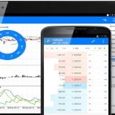
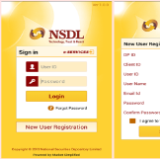
Starting Investment in Capital Market
Accounts Required
Bank Account
Trading or Broking Account
Demat Account
Many DPs offer a 3-in-1 account opening facility which gives you the convenience of opening a trading, demat and bank account – all together. Now some DPs are now offering online demat account opening. Trading or Broking account is required only if you want to buy / sell shares through stock exchange.

Slide 4




About NSDL
Established in 1996, First Depository in India
One of The World’s Largest
Depository
Wide Network of Depository Participants Across The Country

Slide 5
NSDL’s Progress
June
2021
Dec.
2020
Dec.
2015
Dec.
2010
67.56
119.30
227.51
267.42
Custody Value in ₹Lakh Crore - Total Value Of All Assets Held In All NSDL Demat Accounts

Slide 6
NSDL’s Progress

Slide 7
NSDL’s Progress

Slide 8





Indian Capital Market - Depository System
Issuer Company / RTA
Clearing Corporation (NSE Clearing Limited/ Indian Clearing Corporation Limited)
Other Depository
DP 1
DP 2
Stock Broker / Trading Member 1
Stock Broker / Clearing Member 2
Investor 1
Investor 2

Slide 9







Services offered by Depository Participant
Account Opening
Change in account details
Demat*, Remat of securities,
Conversion & Redemption of Mutual Fund Units
Account freeze
(Account level, ISIN level
and Quantity level)
Transfer of securities**
Pledge and Margin Pledge of securities
*Even unlisted shares can be dematerialized. **Transfer of securities held in physical form not allowed w. e. f. April 1, 2019. Re-lodgement of transfer deeds which were submitted prior to this, but were rejected or returned, was allowed till March 31, 2021. Shares pending for transfer with listed company / its RTA shall be issued only in demat.

Slide 10
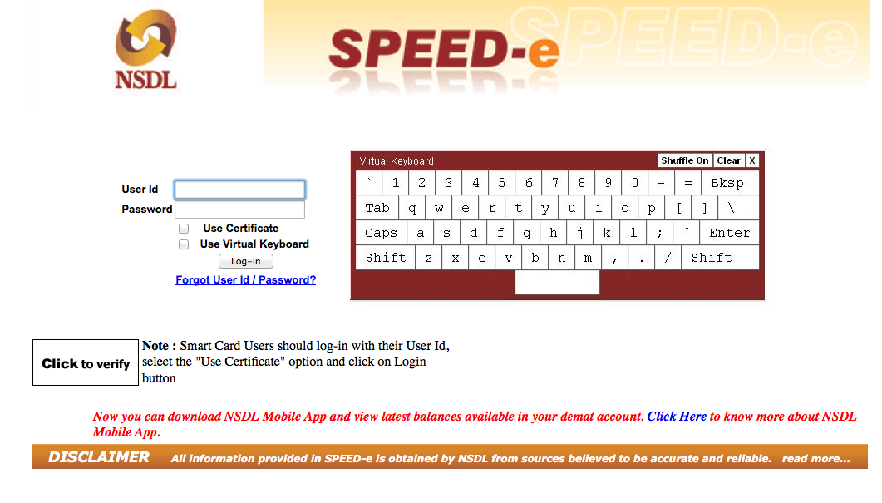


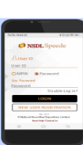
NSDLs Investor Centric e-Services
NSDL's internet facility to enable users to submit various instructions online, including Margin Pledge
You may register at www.nsdl.co.in
View transactions, holdings along with valuation
Subscribe to CAS
Update email ID for CAS
View and download 12 past CAS
Participate in e-Voting
*
Facility for shareholders to vote electronically on resolution of companies, Anytime, Anywhere
View holdings along with valuations
Participate in e-Voting
Confirmation of e-DIS
Register for IDeAS
NSDL
e-Voting*
NSDL Speed - Mobile App*
*Free for all demat account holders

Slide 11

Be a Prudent Investor
Keep record of documents signed, account statements, contract notes received and payments made. Save important emails and take periodic back up of data.
Change password of your online accounts frequently. Never share OTP and PIN with any one.
Read SMS, emails, letters, statements, bills sent by your broker, bank, DP and NSDL. These are sent to you to keep you updated.
Accept the DIS only if serial number is pre printed and Client ID is pre stamped or pre printed. Keep DIS in safe custody.

Slide 12
Be a Prudent Investor
Inform your DP about any change in your Personal Information such as address, bank account immediately.
Always mention your Mobile Number and email ID in account opening form and keep them updated. Do not act on Unsolicited SMS and emails providing Tips, stock recommendations, assured returns etc.
Our publications are available in Hindi, English and other languages at www.nsdl.co.in → Education
Schedule of Awareness Programs, Registration and Feedback facilities are available at www.nsdl.co.in

Slide 13
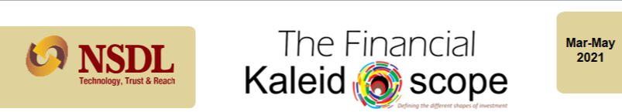

NSDL Newsletter for Investors
The Financial Kaleidoscope – Free monthly newsletter in हिंदी Hindi and English
www.nsdl.co.in
Education
Newsletter – The Financial Kaleidoscope

Slide 14

Grievances Redressal
Lodge your complaint with SEBI at www.scores.gov.in/ or SEBI Mobile App
SEBI Toll free helpline - 18002667575 / 1800227575
NSDL Toll Free helpline - 18001020990 / 1800224430
Online submission of Grievances at www.nsdl.co.in Query Now
NSDL email for grievance - relations@nsdl.co.in
NSDL email for other information - info@nsdl.co.in

Slide 15

Why Do We Invest?
Investment is necessary to support your financial needs when you do not earn money.
By investing a portion of your income you allow money to grow and work for you.
3 parameters to assess suitability of any investment avenue are –
Return potential
Safety
Liquidity
Various avenues where money can be invested, are broadly classified into some groups, known as ‘Asset Class’. Stocks or Equity shares are most popular class of assets.

Slide 16

What is meant by Stock Selection?
Stock selection is the selection of one or more stock (or shares) based on certain set of criteria in order to maximise the probability of meeting the trading or investment objective.
There are more than 5000 stocks available for trading or investment. None can trade or invest in all at the same time.
Hence, one needs to select a manageable number of stocks.
Fundamental and Technical Analysis are the two most preferred tools for stock selection.

Slide 17
Types of Analysis
Economic
Fundamental
Technical
Quantitative
Qualitative

Slide 18

Fundamental Analysis
Fundamental analysis is a method used to identify the true value of a stock.
The current price of a stock may not reflect the actual value of the stock. The stock may be overvalued or undervalued in the market.
Fundamental analysis helps investors to study the health of the company, and thus leading to the actual value of the stock.
This is done by using various qualitative and quantitative factors.
The main purpose of this method is to identify companies that that are fundamentally strong in order to invest in them for the long term.

Slide 19
Economic Analysis
It involves assessing or examining topics or issues from an economist’s perspective
This allows investors to analyse the market from the big picture to all the way down to individual stocks.
By examining the economic numbers one can determine the current market strength and have a better idea of what the future holds.
Key Economic indicators investors must incorporate while selecting stocks:
Indices (e.g. Nifty, Sensex)
GDP
Unemployment rate
Inflation rate
Consumer Confidence
Purchase Managers' Index

Slide 20

Types of Fundamental Analysis
Qualitative Analysis
It takes into account information that can’t be expressed in numbers.
It relates to the company itself.
Factors – examples –
Management experience and performance
Corporate governance
Industry and competition etc.

Slide 21

Types of Fundamental Analysis
Quantitative Analysis
It is related to information that is shown in company’s financial statements. It involves measuring simple statistical data to complex calculations
This analysis helps you to evaluate investment opportunities such as when to buy and sell securities.
Factors – examples -
Company’s revenues
Profit margins
Return on equity
Future growth potential
Financial ratios

Slide 22
Using Financial Ratios for Fundamental Analysis
1. Price To Earnings Ratio
It is one of the most widely used financial ratio analysis.
Computation - Price Per Share / Earnings Per Share
As a thumb rule, a low P/E ratio is preferred while buying a stock.
2. Price To Book Value
Computation - Current price of the stock / Book value per share.
A lower P/BV ratio could mean that the stock is undervalued.
However, the definition of lower varies from sector to sector.

Slide 23
Financial Ratios
3. Return On Equity (ROE)
It is the amount of net income returned as a percentage of shareholders equity.
Computation - Return on Equity (Net Income) / Average Stockholder Equity
4. Debt To Equity Ratio
It measures the relationship between the borrowed capital (i.e. debt) and the capital contributed by shareholders (i.e. equity).
Computation - Total Liabilities / Total Shareholder Equity
As a thumb of rule, companies with a debt-to equity ratio more than 1 are riskier.

Slide 24
Financial Ratios
5. Current Ratio
It is a key financial ratio for evaluating a company's liquidity.
Computation - Current Assets / Current Liabilities
As a thumb rule, a company with a current ratio greater than 1 is better.

Slide 25
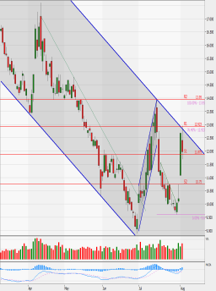
Technical Analysis
It focuses on the stock market, rather the company.
It seeks to predict price movements by examining historical
data, mainly price and volume.
The underlying idea is that the market price already reflects the fundamentals of any given stock, which therefore can be ignored.
It is a good idea for investors to leverage both technical and fundamental analysis to fill the gaps.

Slide 26
Basic Terms Used in Study of Price Charts
Term | Meaning
Support Level | A level below which the price will likely not fall
Resistance Level | A level above which the price will not likely rise
Breakout | When a stock rises above its resistance level or falls below its support level
Trend line | A regression line that predicts future prices based on past prices
Relative strength | Ratio of the percentage price change of a stock to the percentage price change of a broader index or another stock

Slide 27
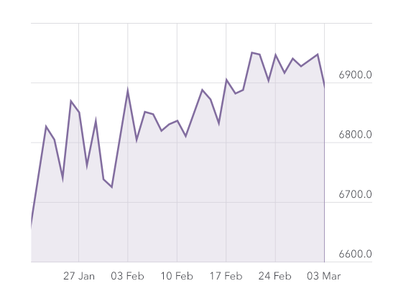
Price Charts
Technical analysts use a variety of charts based on the information they seek. However, there are three types of charts that are most commonly used. They are: Line, Bar and Candlestick
Line Charts
This is one of the most familiar charts which plot the price of a share against a trading day. It usually depicts the closing price and the duration for which this is plotted could range from a few days to few years depending on the need. The line formed by joining the dots plotted on the graph shows the movements in stock price during the period.

Slide 28
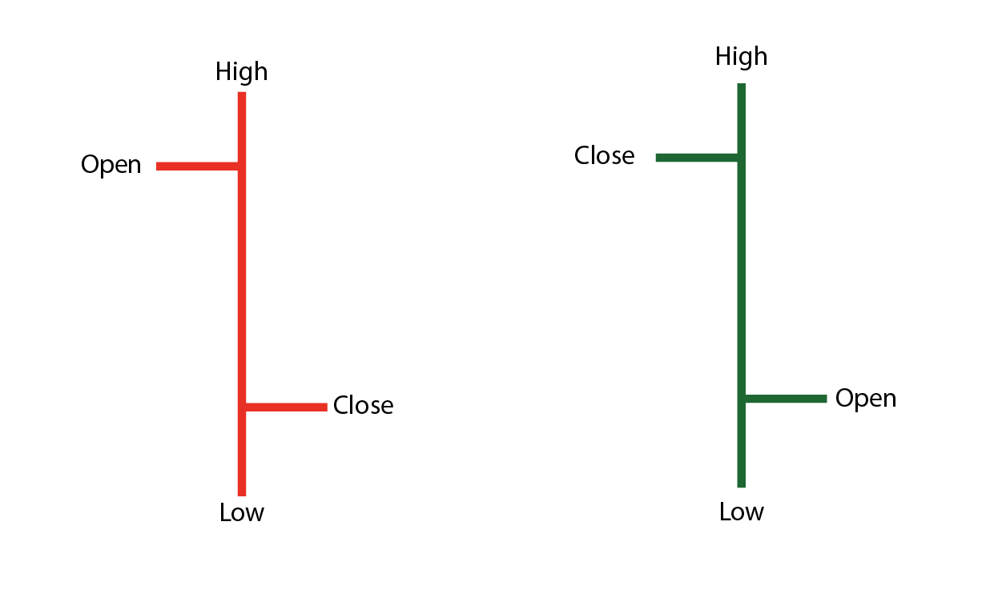
Price Charts
Bar Chart
It plots the intra-day high and low prices of a stock using a bar for each trading day for a specified time period.
The top of the bar corresponds to the day’s high and the bottom, day’s low.
Two additional horizontal lines indicate the opening and closing price. The length of the bar is proportional to the volatility in a stock.
Colored coded - If the share price closes above the open price it is colored green, and if the close is below the open the bar is colored red.

Slide 29
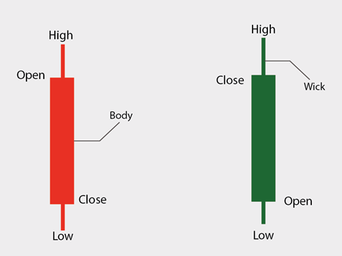
Price Charts
Candlestick chart
It displays the relationship between the high & low and opening & closing prices of a stock.
The body of the candle represents the opening and closing prices during the period.
Above and below the body are vertical lines called wicks or shadows that show the lows and highs of the traded prices.
While an individual candle provides sufficient information, patterns can be determined only by comparing one candle with its preceding and next candles.

Slide 30
Difference between Fundamental & Technical Analysis
Fundamental analysis | Technical analysis
Analyses stock value based on economic and financial factors | Analyses historical stock movement to predict the future price of a stock
Long-term approach | Short-term approach
Uses financial statements for analysis | Uses price movement charts for analysis
Incorporates new market information | Focuses mainly on past performance

Slide 31
5 Steps Approach For Great Stock Picking
Approach stock purchases as buying a business rather than just a stock purchase in the portfolio.
Evaluate the true worth of the business considering the future earning potential.
The margin of safety is the real risk containment measure, and not stop loss.
Do not depend on turnaround as it seldom occurs.
Invest for the long term to generate inflation-adjusted superior returns.
So when one asks how to choose stock to invest in, the real question, is how to identify a great business and what all parameters should be used to identify it?

Slide 32

Remember
Always remember your financial goals and investment timeframe.
Review your financial goals periodically, at-least once in 5 years.
Risk and Return profile of various assets are not constant.
Consider taking help from a registered and qualified Investment Advisor.
No stock remain the best all the time. Market is dynamic and you need to review your portfolio periodically.

Slide 33

“Investing money is the process of committing resources in a strategic way to accomplish a specific objective.”
Alan Gotthardt

Slide 34
THANK YOU
We welcome your feedback and suggestions about this program at www.nsdl.co.in / info@nsdl.co.in.

